Slide 1
OOP
Module 1Part 11)
Prepared by Renetha J.B.
Prepared by Renetha J.B.

Slide 2
Topics
Core Java Fundamentals:
Object Oriented Programming in Java
  Class Fundamentals
  Declaring Objects
  Object Reference
  Introduction to Methods.
Prepared by Renetha J.B.

Slide 3
Class Fundamentals
The class is the core of Java.
  The class forms the basis for object-oriented programming in Java.
A class is a "blueprint" for creating objects
A class is a template for an object.
  An object is an instance of a class.
A class defines a new type of data.
A class creates a logical framework that defines the relationship between its members.
Prepared by Renetha J.B.

Slide 4
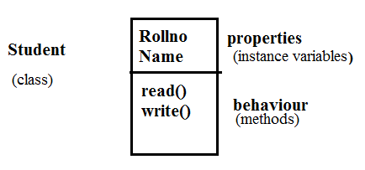

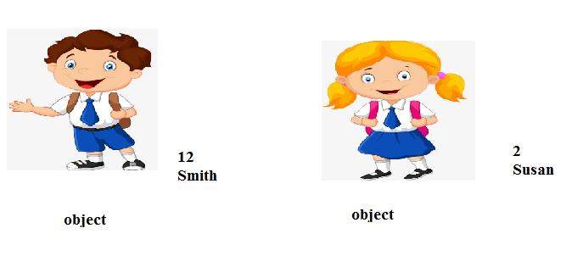
Example
Prepared by Renetha J.B.

Slide 5
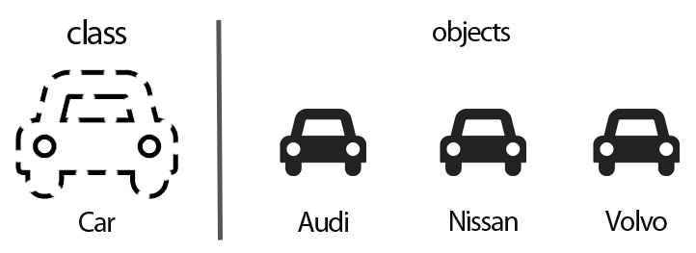
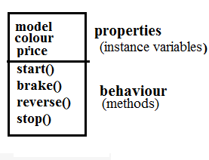
Prepared by Renetha J.B.

Slide 6
Class(continued.)
A class is declared using the keyword class
The data or variables, defined within a class are called instance variables.
  because each instance of the class (that is, each object of the class) contains its own copy of these variables.
  the data for each object is separate and unique.
Functions inside class are called methods.
The methods and variables defined within a class are called members of the class.
Prepared by Renetha J.B.

Slide 7
The General Form of a Class
A general form of a class definition is
class classname
{
  type instance-variable1;
  type instance-variableN;
  type methodname1(parameter-list)
  {
  // body of method
  }
  type methodnameN(parameter-list)
  { // body of method
  }
}
Properties
(instance
variables)
Behaviour or
Method or
function
Members of class
Behaviour or
Method or
function
Prepared by Renetha J.B.

Slide 8
A Simple Class
class Box
{
double width;
double height;
double depth;
}
Properties
(instance variables)
Member of class
Prepared by Renetha J.B.

Slide 9
A Simple Class
class Box
{
double width;
double height;
double depth;
void volume()
{
//statements
}
}
Properties
(instance variables)
Members of class
Behaviour or
Method or
Function
Prepared by Renetha J.B.

Slide 10
Declaring Objects
When we create a class, we are creating a new data type.
  We can use this type to declare objects of that type.
Obtaining objects of a class is a two-step process.
  First, we must declare a variable of the class type.
    This variable does not define an object.
    It is simply a variable that can refer to an object.
  Second, we must acquire an actual, physical copy of the object and assign it to that variable (using new operator)
Prepared by Renetha J.B.

Slide 11
Declaring Objects(contd.)
Classname objectname ; // declare reference to object
objectname = new Classname(); // allocate an object
We can write this in a single statement
Classname objectname = new Classname();
Prepared by Renetha J.B.

Slide 12
class Box
{double Width;
double Height;
double Depth;
}
Box mybox;
This line declares mybox as a reference to an object of type Box.
Here mybox contains the value null, which indicates that it does not yet point to an actual object
mybox = new Box();
This line allocates an actual object and assigns a reference to it to mybox.
mybox holds the memory address of the actual Box object.
Prepared by Renetha J.B.

Slide 13
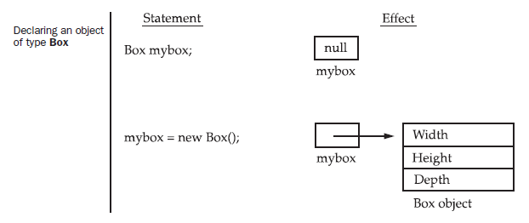
Declaring Objects(contd.)
class Box
{double Width;
double Height;
double Depth;
}
Prepared by Renetha J.B.

Slide 14
Declaring Objects(contd.)
The class name followed by parentheses specifies the constructor for the class.
Box mybox=new Box();
Here Box is the class. Box()is the constructor.
A constructor defines what occurs when an object of a class is created.
Prepared by Renetha J.B.

Slide 15
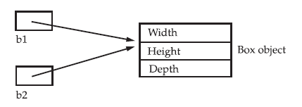
Assigning Object Reference Variables
Object reference variables act differently when an assignment takes place
E.g.
Box b1 = new Box();
Box b2 = b1;
Here b1 and b2 will both refer to the same object.
Any changes made to the object through b2 will affect the object which is referred by b1, because they are the same object.
Prepared by Renetha J.B.

Slide 16
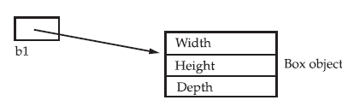
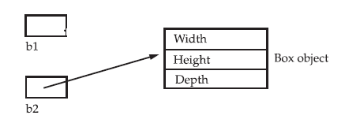
Assigning Object Reference Variables
(contd.)
Box b1 = new Box();
Box b2 = b1;
// ...
b1 = null;
Here at the end b1 has been set to null, but b2 still points to the original object.
b2
Prepared by Renetha J.B.

Slide 17
Class vs object
Class
Object
Template for creating objects
Logical entity
Declared using class keyword
Class does not get any memory when it is created.
A class is declared only once
Instance of class
Physical entity
Created using new operator.
Object gets memory when it is created using new operator.
Many objects can be created from a class
Prepared by Renetha J.B.

Slide 18
Introducing Methods(Functions)
Classes usually consist of two parts:
  Instance variables
  Methods or functions.
The general form of a method(function):
type name(parameter-list)
{
// body of method
}
The type specifies the type of data returned by the method.
  any valid type, including class types, void
The parameter-list or argument list is a sequence of type and identifier pairs separated by commas.
Prepared by Renetha J.B.

Slide 19
int add()
{
int a=5+2;
return(a);
}
float display()
{
float s=5.0;
return(s);
}
void display()
{
float s=5.0; }
Prepared by Renetha J.B.

Slide 20
Introducing Methods(contd.)
Methods that have a return type other than void return a value to the calling routine using the following form of the return statement:
return value;
Method of one class can be invoked by functions of other classes through objects of former class.
Objectname.method(parameters);
Prepared by Renetha J.B.

Slide 21
Create a class Box with instance variables length, width and height. Include a method volume to compute the volume of the box.
Create another class BoxDemo with main function that creates an object of class Box named mybox1 and set the values for instance variables(length, width and height). Invoke the function volume in Box to compute the volume of the created object mybox1
Prepared by Renetha J.B.

Slide 22
// EXAMPLE
class Box {
  double width;
  double length;
  double depth;
  void volume()
  {
  System.out.print("Volume is ");
  System.out.println(width * height * depth);
  }
}
class BoxDemo {
public static void main(String args[]) {
Box mybox1 = new Box();
mybox1.width = 10;
mybox1. length = 30;
mybox1.depth = 15;
mybox1.volume();
} }
Properties
(instance variables)
Behaviour or
Method or
Function
Box class
Behaviour or
Method or
Function
MAIN FUNCTION
Object of class Box
BoxDemo class
Prepared by Renetha J.B.

Slide 23
// EXAMPLE
Import java.util.*;
class Box {
  double width;
  double length;
  double depth;
  void volume()
  {
  System.out.print("Volume is ");
  System.out.println(width * height * depth);
  }
}
class BoxDemo {
public static void main(String args[]) {
Scanner sc=new Scanner(System.in)
Box mybox1 = new Box();
mybox1.width = sc.nextDouble();
mybox1. length = sc.nextDouble();
mybox1.depth = sc.nextDouble();
mybox1.volume();
} }
Properties
(instance variables)
Behaviour or
Method or
Function
Box class
Behaviour or
Method or
Function
MAIN FUNCTION
Object of class Box
BoxDemo class
Prepared by Renetha J.B.

Slide 24
Example
Create a class Box with instance variables length, width and height. Include a method volume to compute the volume of the box and return the value of volume,
Create another class BoxDemo with main function that creates an object of class Box named mybox1 and set the values for instance variables(length, width and height). Invoke the function volume in Box to compute the volume of the created object mybox1.
Prepared by Renetha J.B.

Slide 25
// program using return statement
class Box {
  double width;
  double height;
  double depth;
  double volume()
  {
  return(width * length * depth);
  }
}
class BoxDemo
{
  public static void main(String args[])
  { Box mybox1 = new Box();
  mybox1.width = 10;
  mybox1.height = 20;
  mybox1.depth = 15;
  double v=mybox1.volume();
  System.out.println(”Volume=“+v);
} }
OUTPUT
Volume is 3000.0
Prepared by Renetha J.B.

Slide 26
class Rectangle
{
private int length;
private int breadth;
public Rectangle(int l, int b)
{
length = l;
breadth = b;
}
public int area()
{
return length * breadth;
}
}
class Sample
{ public static void main(String[] args)
{ Rectangle rect = new Rectangle(2,3);
int result = rect.area();
System.out.println("Area of rectangle: " + result);
}
}
OUTPUT
Volume is 6
Prepared by Renetha J.B.

Slide 27
Reference
Herbert Schildt, Java: The Complete Reference, 8/e, Tata McGraw Hill, 2011.
Prepared by Renetha J.B.

